Slide 1



Healthcare Costs Prediction Using Bayesian Linear Regression A Comparison with Frequentist Models
Yejin Hwang

Slide 2
01
Introduction

Slide 3
Abstract/Overview
This project compares Bayesian and Frequentist linear regression models for predicting healthcare costs.
The analysis uses the Medical Cost Personal Dataset, which includes demographic and medical variables.
The Bayesian model incorporates priors, nonlinear terms, and interactions, producing credible intervals for interpretation.
Goal: To evaluate each model's predictive performance and ability to handle uncertainty.

Slide 4
Introduction & Motivation
Accurate healthcare cost prediction supports budgeting, insurance planning, and policy decisions.
Traditional (frequentist) models provide point estimates but lack uncertainty quantification.
Bayesian methods offer full posterior inference, flexible modeling, and clearer interpretation.
Research Question: Can Bayesian regression provide comparable prediction performance while offering better uncertainty estimates and interpretability?

Slide 5
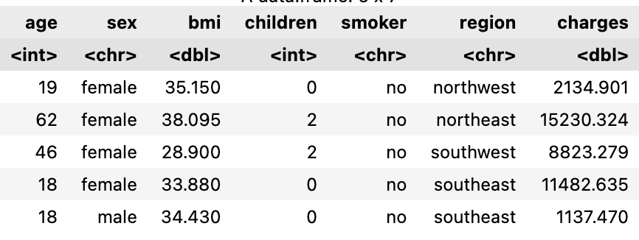
Dataset
Dataset: Medical Cost Personal Dataset (Kaggle)
Sample size: 1338 individuals
Variables(7): age, sex, bmi, children, smoker, region, charges
target variable : charges (Individual medical costs billed by health insurance)
no missing values
18-64
f/m
15-53
0-5
yes/no
4(US)
Next slide!

Slide 6
Exploratory Data Analysis(EDA)
Notes:
"Before modeling, I conducted exploratory data analysis to understand key features and relationships in the data."

Slide 7
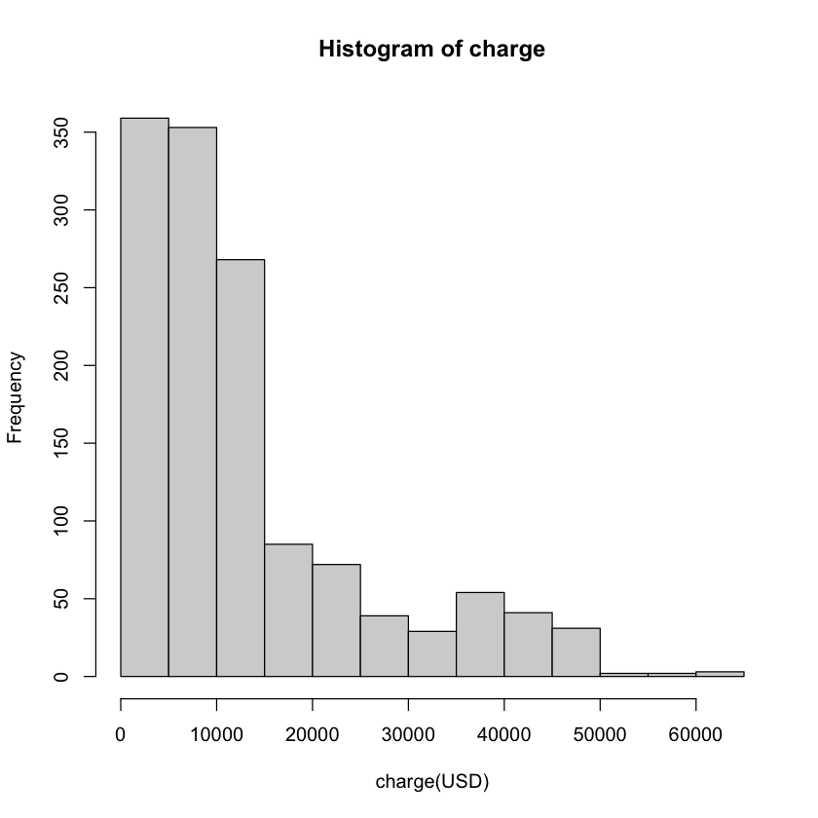
Most charges in this group are below $20,000, and high-cost outliers are rare.

Slide 8
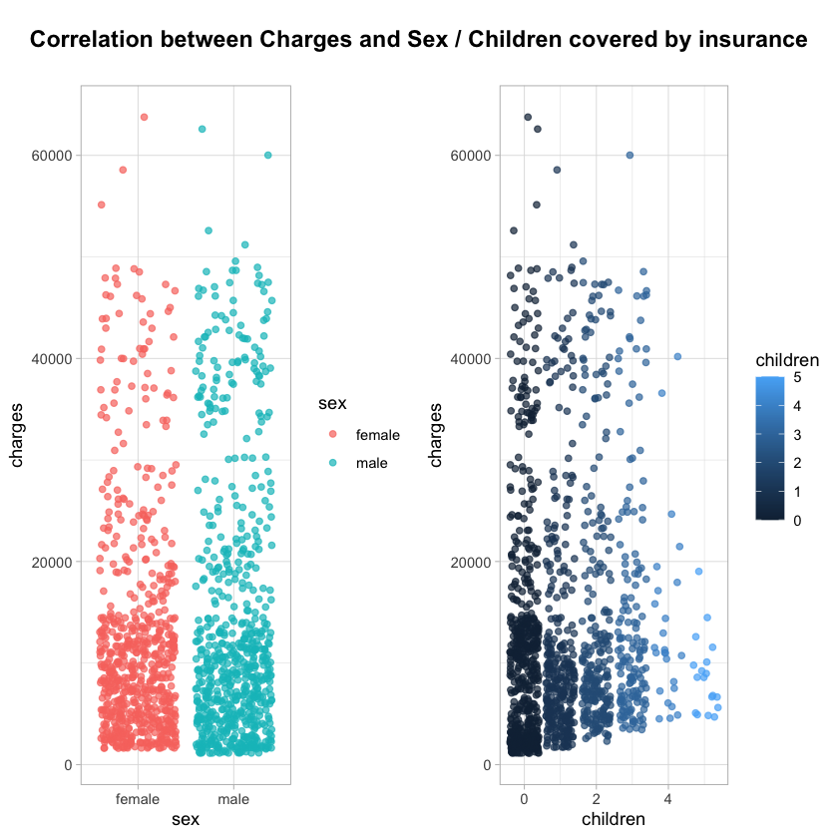
[Charges and Sex]
Overall, there is no significant difference in the distribution of charges between males and females.
This suggests that sex may not be a strong standalone predictor of healthcare costs in this dataset,
→ Therefore, it was excluded from the final model.
[Charges and Children]
Charges for insurance with 4-5 children covered seems to go down.
In general, the number of children alone still shows limited predictive power.

Slide 9
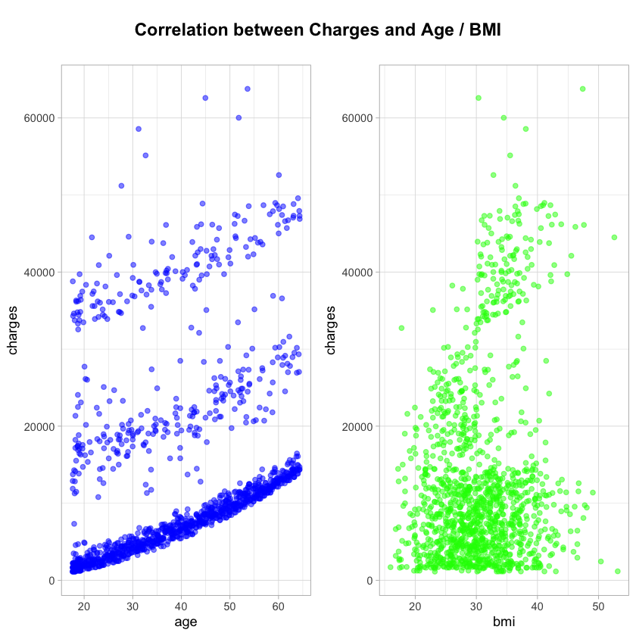
[Charges and Age]
clear positive correlation between age and medical charges. As people get older, their medical expenses tend to increase.
Furthermore, the layered appearance of data points suggests that age may interact with other variables, such as smoking status or BMI, influencing medical charges in a more complex way.
[Charges and BMI ]
Unlike age, the correlation here is weaker and more scattered. While there is a slight upward trend, particularly among individuals with higher BMI (above 35), the association is not consistent.
This suggests that BMI alone is not a strong predictor of medical charges, and its effect may depend on interactions with other variables such as age or smoking status.

Slide 10
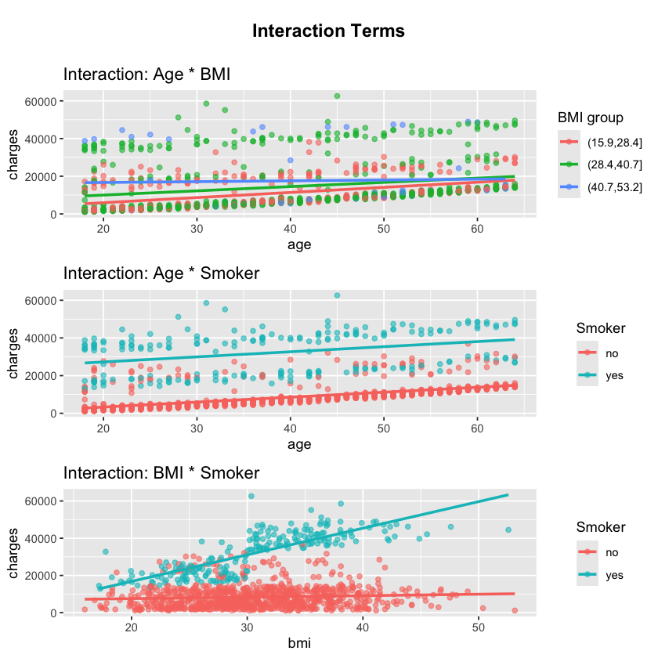

[Age * BMI] & [Age * Smoker] There is a slight upward trend between variables, but the interaction effect remains relatively weak.
→ Given the weak effects, these interactions were excluded from the final model.
[BMI * Smoker] This interaction is much stronger. For smokers, charges increase sharply with higher BMI, while for non-smokers, the pattern remains flat.
→ Thus, only BMI × Smoker was included as an interaction term in the final Bayesian model.
Weak
Strong!

Slide 11

02
Methodology
Notes:
Let me briefly go over the methods I used to build

Slide 12
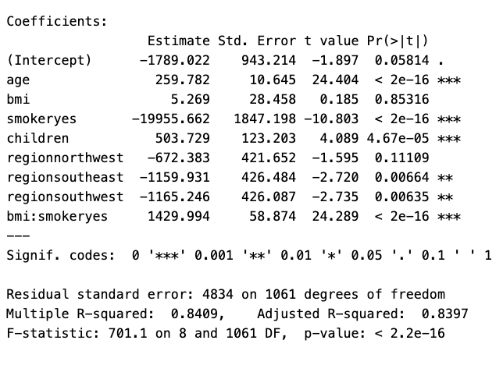
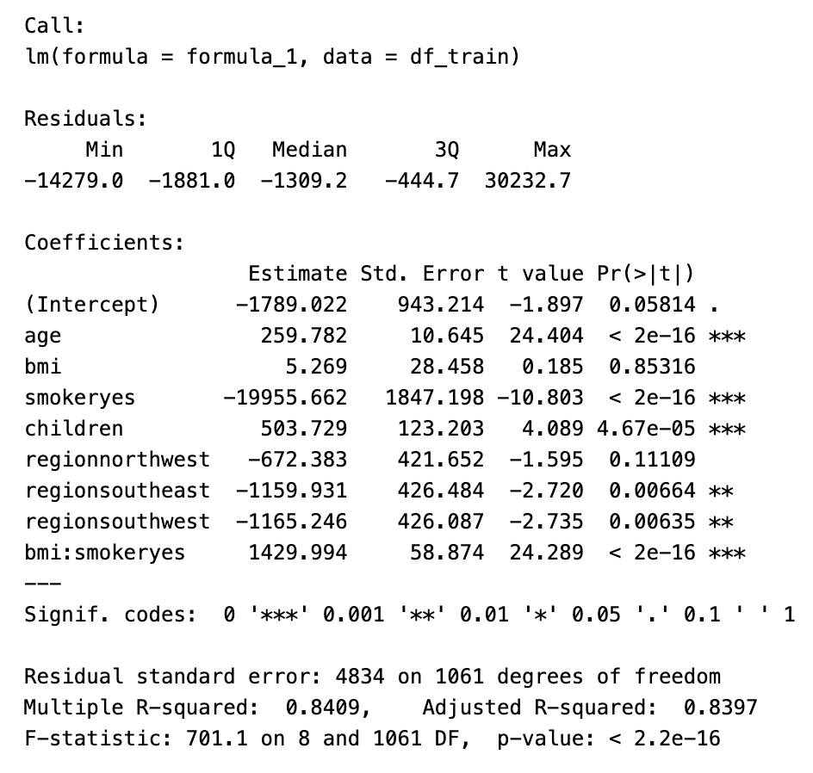
Frequentist Model
Nonlinear term: age² to capture acceleration in healthcare costs with age.
Key interactions: BMI × smoker
Significant predictors include age, children, smoker, and bmi × smoker
Notes:
I include every variable except sex, because it was not significant variable for prediction.
Regional effects are modest, with some significance for southeast and southwest

Slide 13
Bayesian Model

Slide 14
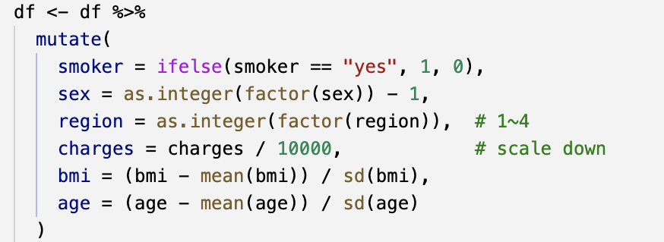
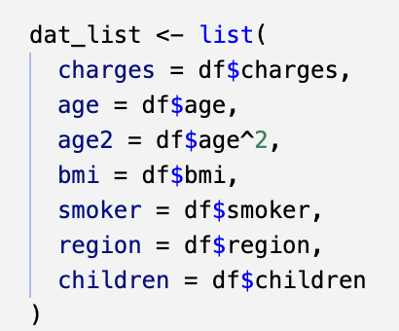
Variable Processing
→ converted to binary (1 = "yes", 0 = "no")
→ converted to integer index(1-4)
→ scaled down by 10,000 to improve model stability
→ age and bmi standardized (mean = 0, sd = 1) for better convergence

Slide 15
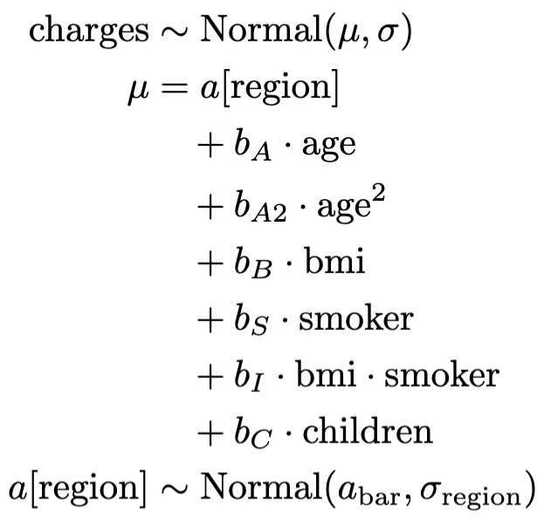
Model Fitting
Fit using rethinking R package with HMC(Hamiltonian Monte Carlo)
Nonlinear term: age² to capture acceleration in healthcare costs with age.
Key interactions: BMI × smoker
Group-level intercepts for region, using partial pooling through hierarchical priors to capture individual and group-level effects.
→ This allows the model to generalize better while capturing important structure in the data.

Slide 16
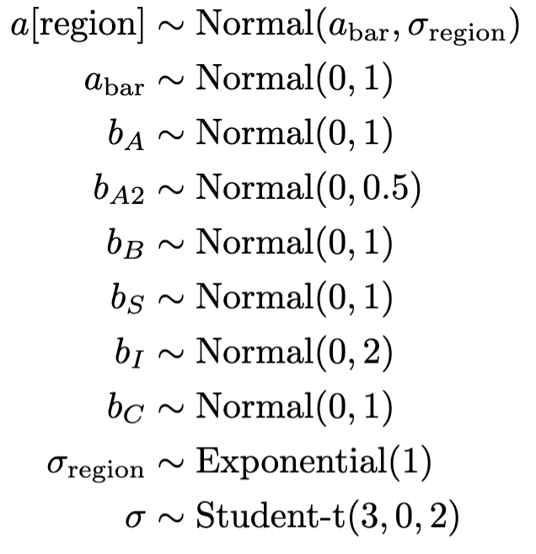
Priors
Normal priors used for all coefficients (centered at 0).
Narrower prior for age² to regularize nonlinear effect.
Wider prior for bmi × smoker to allow stronger interaction.
Each region gets its own intercept a[region], drawn from a common distribution
→ It allows partial pooling and better generalization.
Student-t prior on σ to improve robustness against outliers.
Notes:
each region gets its own intercept a[region], drawn from a common distribution. This allows partial pooling and better generalization.”
📌 왜 Exponential(1) 로 설정할까?
1. 표준편차는 반드시 양수여야 해요
→ 정규분포의 표준편차 σ\sigmaσ는 음수가 될 수 없으니까, Normal(0, 1) 같은 건 안 돼요. 그래서 양수만 나오는 분포를 선택해야 해요.
2. Exponential 분포는 0에 집중되고 긴 꼬리를 가짐
→ 대부분 작은 값에 몰려 있어서 “pooling을 많이 하게” 만들고, → 아주 큰 σregion\sigma_{\text{region}}σregion​ 도 가능은 하지만 덜 선호하게 해요.
이렇게 하면 region 간 차이가 너무 커지는 걸 방지하고, 동시에 데이터가 강하게 말해줄 경우엔 큰 값도 허용해 줘요. 이게 바로 "shrinkage (수축 효과)" + 유연성 조합이에요.

Slide 17
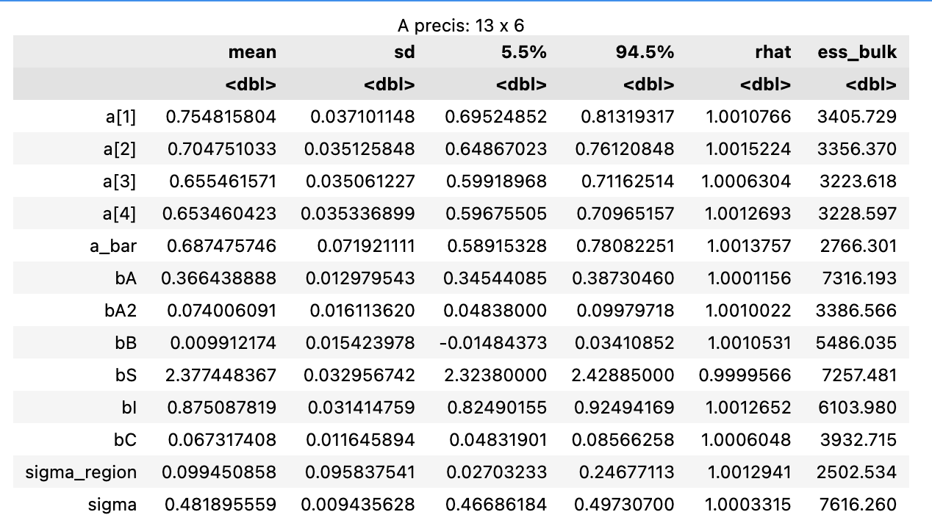
Posterior summary
Effective sample size
Rhat ≈ 1.00
Ess bulk > 1000 for all
The Strongest effects
→ good convergence and effective sampling
→ Being a smoker increases expected charges
→ Charges increase more steeply with BMI for smokers

Slide 18
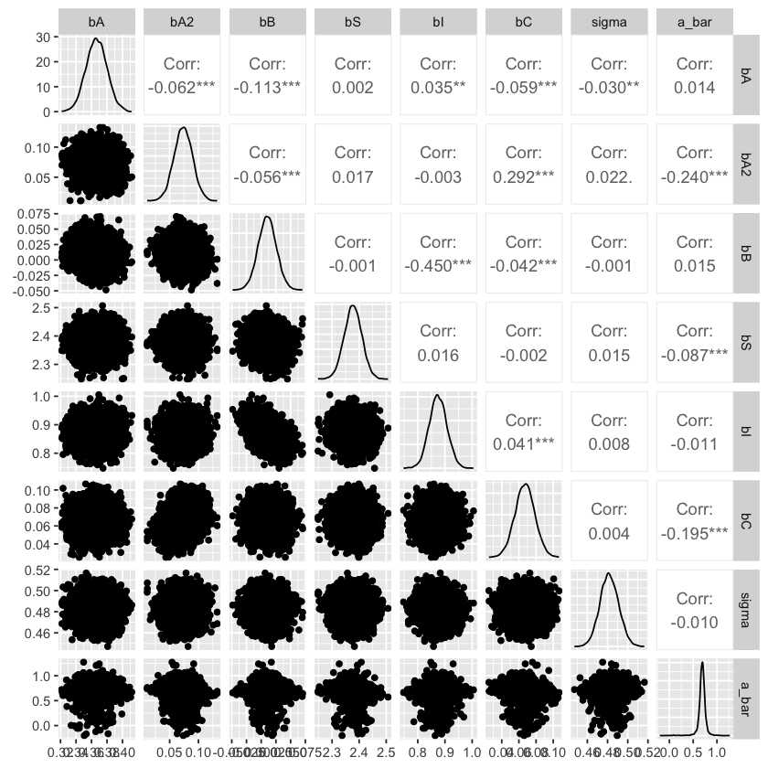
Posterior distribution
Posterior samples of parameters are shown with pairwise correlations.
Most parameters have weak correlations (near zero), suggesting low collinearity.
Distributions look approximately normal.

Slide 19
RESULT
03
Notes:
CLS stands for "Classification" ,the CLS token is used to summarize global image information for classification. ViT processes an image by dividing it into small patches, treating each patch as a token in a Transformer model.
However, to classify the entire image, a CLS token is introduced to store global information.
Without registers: Feature norm distribution shows higher variance, indicating instability in the feature extraction process
.With registers: The feature distribution becomes more uniform, meaning the model extracts features more consistently.
This stabilization can help improve downstream tasks such as object detection and segmentation.

Slide 20
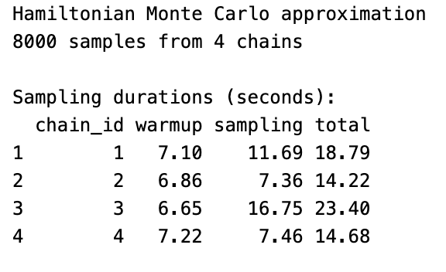
Result
The model was fit using 8000 samples with 4 chains, each running for 4000 iterations.
This provides robust posterior samples for each parameter.
Each chain converged quickly, with total runtimes between 14–23 seconds.

Slide 21
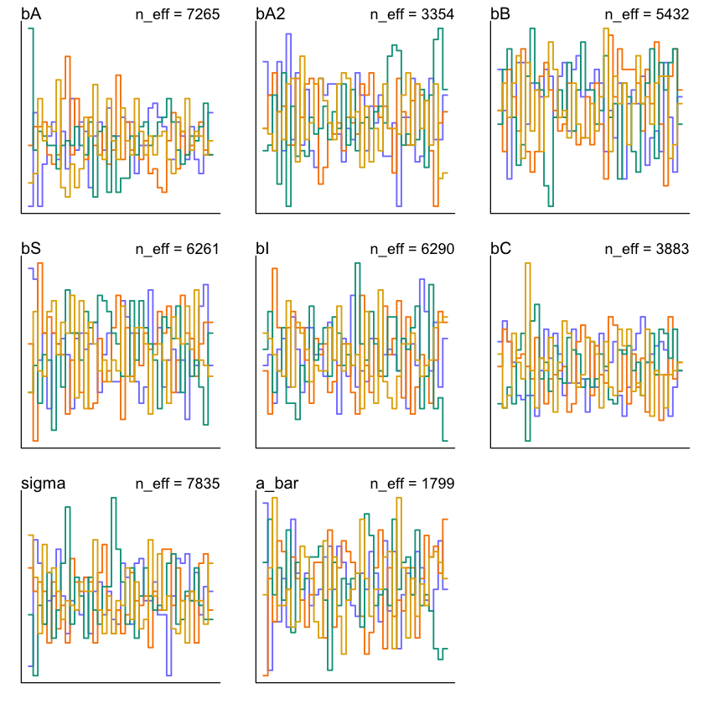
Trankplot
Visualizes the ranks of parameter draws across chains.
All chains are well mixed, no major divergences observed.

Slide 22
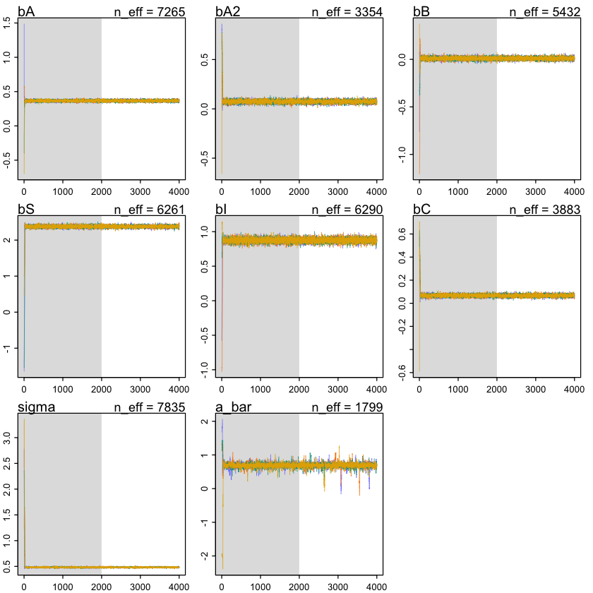
Traceplot
All chains mix well with no signs of divergence or drift.
Burn-in (warmup) phase is shaded gray.
The results suggest convergence is satisfactory and posteriors are reliable for interpretation.

Slide 23
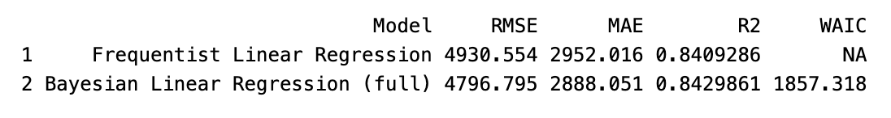
Frequent vs Bayesian
Bayesian model slightly outperformed the frequentist model in both RMSE and MAE
R² values were nearly identical, indicating similar explanatory power
WAIC available only for Bayesian model, which aids in model comparison and validation
Bayesian model provides uncertainty quantification and more interpretable posterior estimates

Slide 24
Conclusion/Limitation
Key Findings
Bayesian regression offered competitive predictive performance
Interaction terms and nonlinear effects improved model expressiveness
Posterior distributions allow uncertainty visualization and deeper interpretation
Limitations
Small dataset size (n = 1338) may limit generalizability
The model assumes Gaussian residuals (could be improved with more flexible likelihoods)
Regional effects are modest. more hierarchical structure (e.g., for smoker subgroups) could be explored

Slide 25
Thank you

